Slide 1
Gesture Recognition Smart Home
Kevin Van Cleave, David Yang, Jiangnan Liu

Slide 2
Motivation
50,000 new amputations every year in USA.
Of all injures reported, injuries to fingers and hands accounted for more than 23%^{[1]}.
Approximately 7.5 million people^{[2]} in the United States have trouble using their voices.
Smart house market will approach 40 billion USD in the US alone by 2020^{[3]}.
Smart home technology should be for everyone.
[1] Bureau of Labor 2014.
[2]National Institute of Deafness and Other Communication Disorders, 2016.
[3]https://www.statista.com/topics/2430/smart-homes/

Slide 3
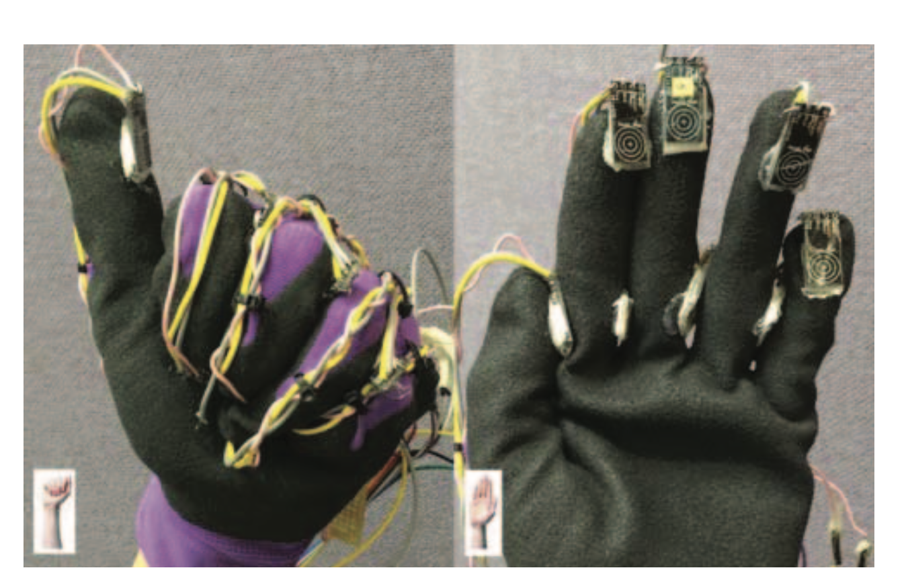
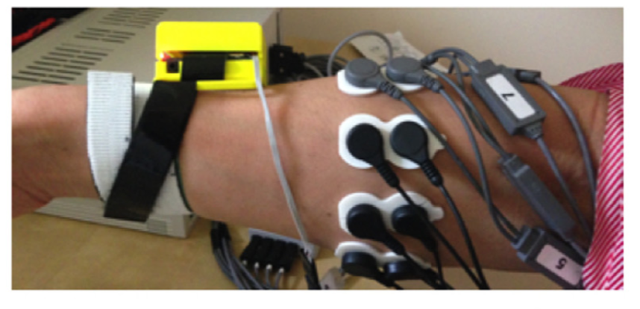
Previous Work
Hand gesture recognition technology:
Vision
Data glove
surface Electromyography (sEMG)
Force Myography (FMG)
Problems:
Lack of privacy
Low accuracy
Inconvenient
Relies on the hand
Expensive
Fig. 1 ^{[1]}
Fig. 2^{[2]}
[1] Abhishek, Kalpattu S., Lee Chun Kai Qubeley, and Derek Ho. "Glove-based hand gesture recognition sign language translator using capacitive touch sensor." 2016 IEEE International Conference on Electron Devices and Solid-State Circuits (EDSSC). IEEE, 2016.
[2] Jiang, Xianta, et al. "Exploration of force myography and surface electromyography in hand gesture classification." Medical engineering & physics 41 (2017): 63-73.

Slide 4
Objectives
A wristband with Force Myography (FMG) that can control smart home devices with hand gestures.
Targets:
Sweat-proof
Inexpensive
User privacy
Accuracy
Low latency response
Customizable

Slide 5





Overview of System
Force Sensor
Force Sensor
(x8)
Arduino
Raspberry Pi 3
Force Sensor
MQTT
Amazon SageMaker
Gyroscope
Accelerometer

Slide 6
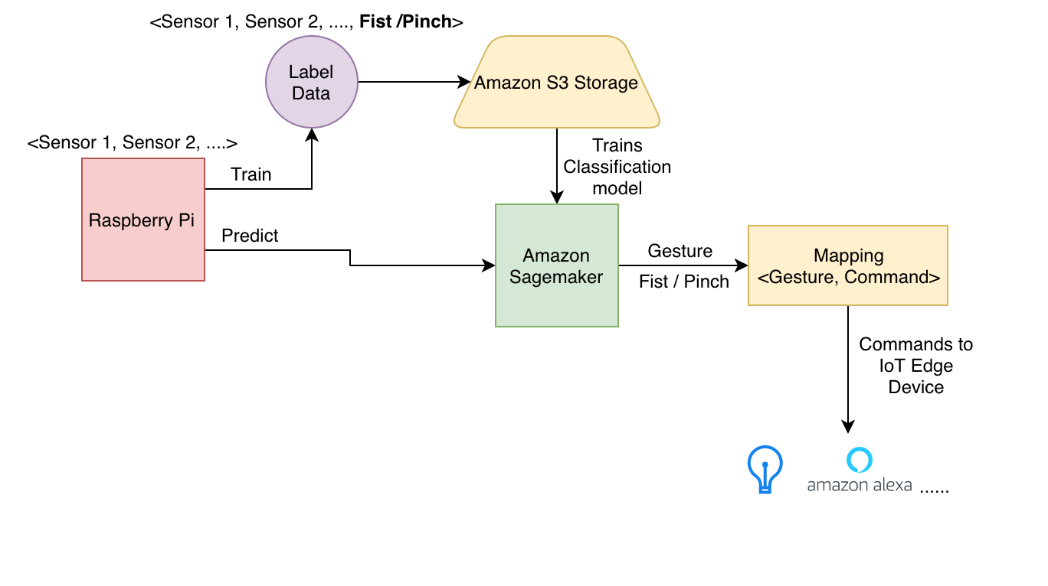
Gesture Classification

Slide 7
Question?

Slide 8
Answer to Questions
Hardware implementation:
Considering a device wearing throughout the day, using AA battery instead of coin cells.^{[1]}
Why smart home:
It is convenient and magical.
Why do you need both cloud and Raspberry Pi?
Raspberry Pi is the edge computing node.
The cloud is more powerful than Pi in machine learning.
Possible “Active Learning” with multiple users
[1] https://electronics.stackexchange.com/questions/5666/are-coin-cells-a-suitable-replacement-for-aa-batteries

